Slide 1
Thank you for downloading this resource pack which contains slides to facilitate 17 sessions covering the following themes:
London Identity
E-Safety
Bullying
Discrimination
Exploitation
Hate crime
Cults and extremism
Sex and the media
Abuse and relationships
Teachers are encouraged to review the slides, notes and videos in advance of each session to ensure they are comfortable with the themes and potential questions that might arise.

Slide 2
Week 3 Session 3: Cults

Slide 3
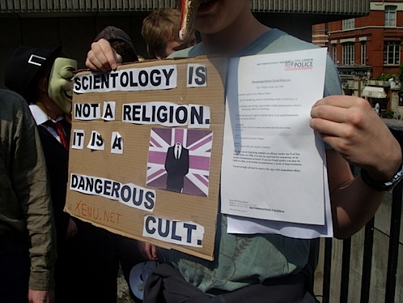
How does this picture make you feel?
A teenager was asked to appear in court for ‘offensive language’ after holding a banner saying, ‘Scientology is not a religion. It’s a dangerous cult!’ outside their headquarters in London.
What is a cult?

Slide 4
Definition of a cult:
We usually refer to cults as the second meaning

Slide 5
How does this make you feel?
What is a cult?
Notes:
http://time.com/4899668/charlottesville-virginia-protest-officer-kkk-photo/
http://www.newstatesman.com/world/2017/08/stand-against-nazis-charlottesville-has-echoes-cable-street

Slide 6
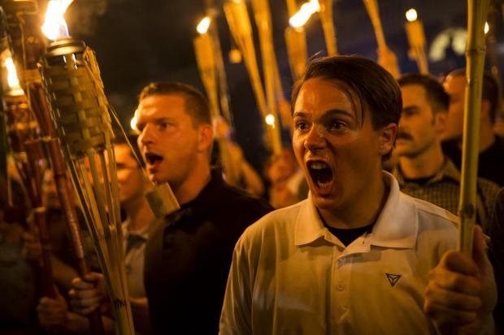
How does this make you feel?
Notes:
http://www.independent.co.uk/news/world/americas/charlottesville-outing-nazis-twitter-man-logan-smith-yes-youre-racist-death-threats-white-a7893881.html

Slide 7
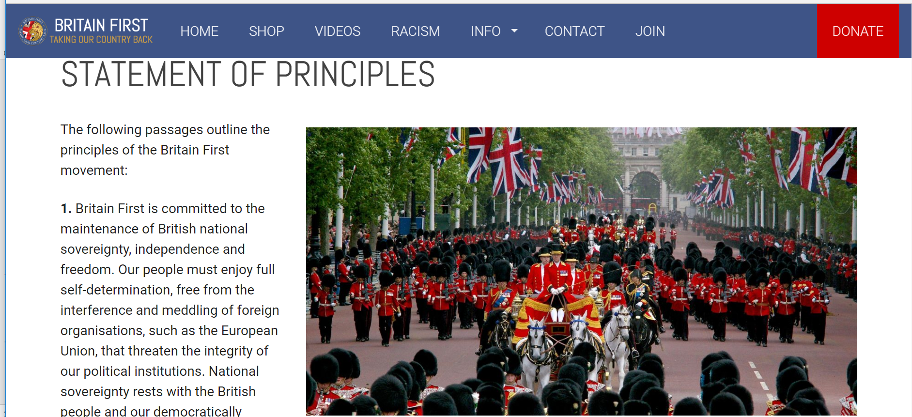
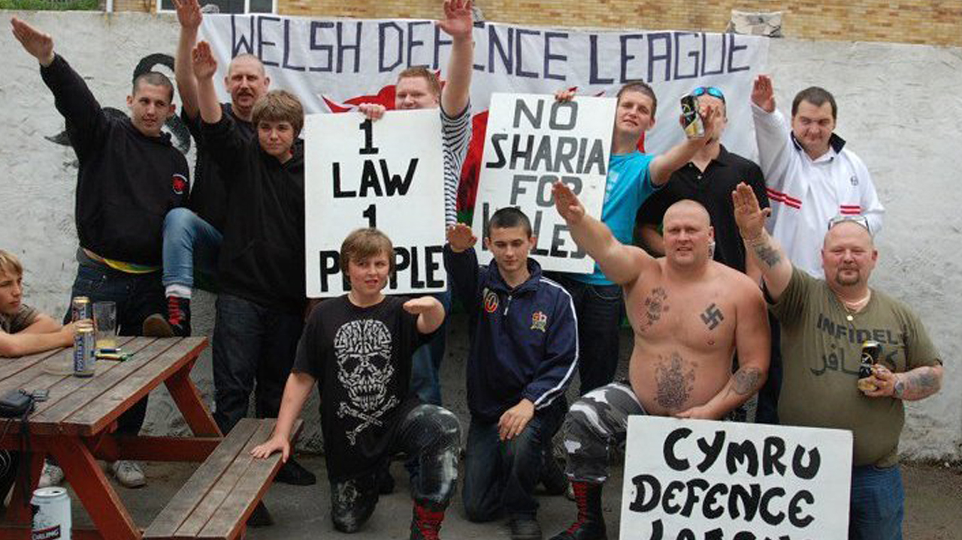
Why might someone be tempted to join groups like these?
Do you think they are cults?
Notes:
Idea of group. Being accepted. Common cause. Fun. ‘Religious justification’ i.e. lots of right wing groups claim they are fighting for Christianity
Especially if you’ve lost contact with friends/family or are trying t find meaning

Slide 8
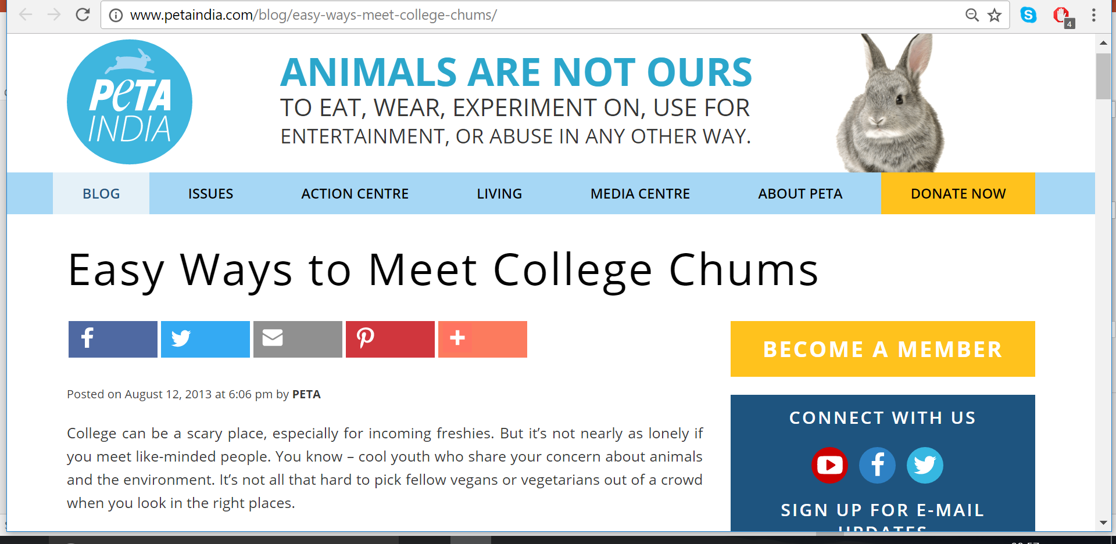
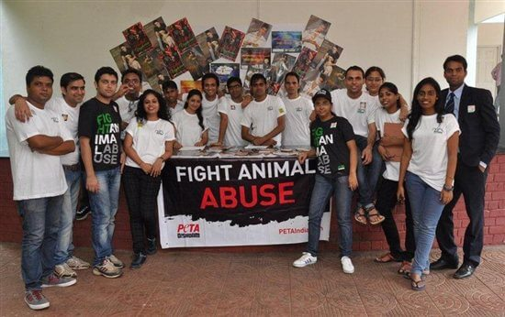
Why might someone be tempted to join groups like these?
Do you think they are cults?
Notes:
http://www.dailymail.co.uk/news/article-2806724/Animal-rights-extremists-offer-Cambridge-undergraduates-money-exchange-personal-details-students-involved-experiments-animals.html
Temptations: money; doing ‘good’

Slide 9
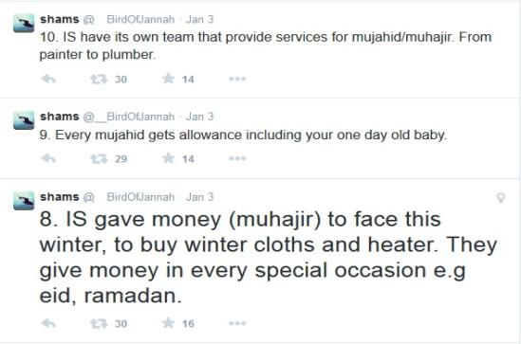
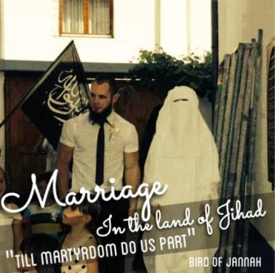
Why might someone be tempted to join groups like these?
Do you think they are cults?
Notes:
As before. ‘Good’ cause, no money worries, love

Slide 10
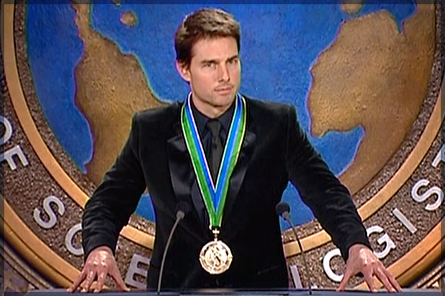
Why might people be scared of cults?
Should we be allowed to criticise groups we consider to be cults?
For next session try to find out a bit about Scientology?
Is it a cult?
Should we treat it with the same respect as we would major religions?

