Slide 1
Thank you for downloading this resource pack which contains slides to facilitate 17 sessions covering the following themes:
London Identity
E-Safety
Bullying
Discrimination
Exploitation
Hate crime
Cults and extremism
Sex and the media
Abuse and relationships
Teachers are encouraged to review the slides, notes and videos in advance of each session to ensure they are comfortable with the themes and potential questions that might arise.

Slide 2
Week 1 Session 3: Staying safe on your phone

Slide 3
What do you think the message behind this advert is?
What other dangers are there using a mobile phone?
Notes:
Session 3

Slide 4
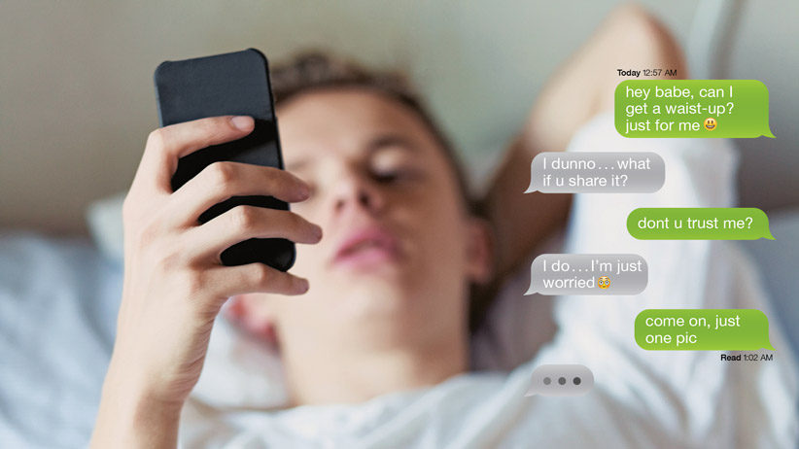
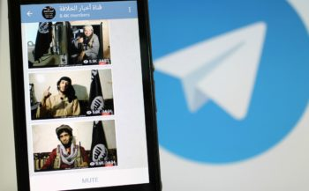
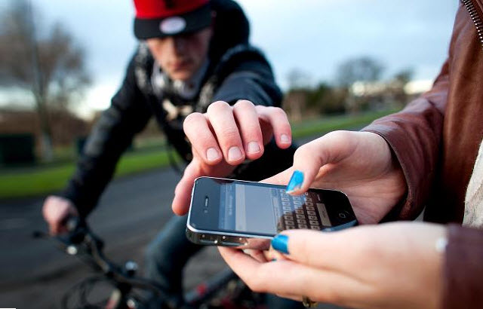
Fake news
Sexting
In pairs choose 1 of these things. How would you summarise the risk?
Propaganda
Theft

Slide 5
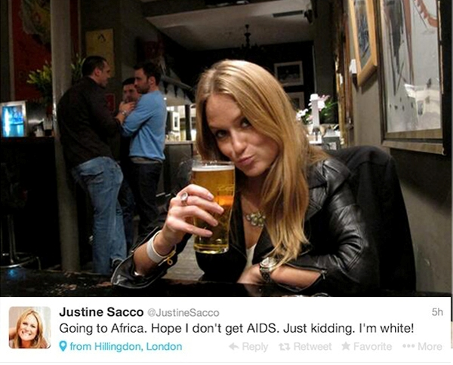
What do you think happened to this woman?
Notes:
Optional slide but helps demonstrate the point of the next slide.

Slide 6
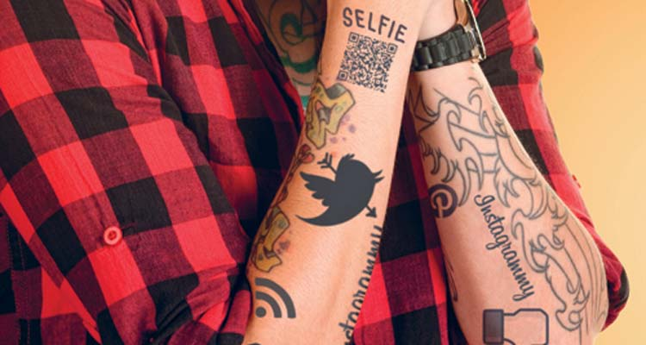
What do you think this picture is supposed to symbolise?
Notes:
Obviously there are a few things. One noteworthy for discussion though is the idea of ‘digital tattoos.’ This means that if you post something online it can be very difficult to erase- i.e like a tattoo.

Slide 7
We are all responsible for using our mobiles safety.
However, if you ever feel pressured into doing something you are not comfortable with then TELL SOMEONE.
You will not get in trouble if you’ve made a mistake. We all do.
In 140 characters or less write a tweet that shows how you should use your phone safely

