Slide 1
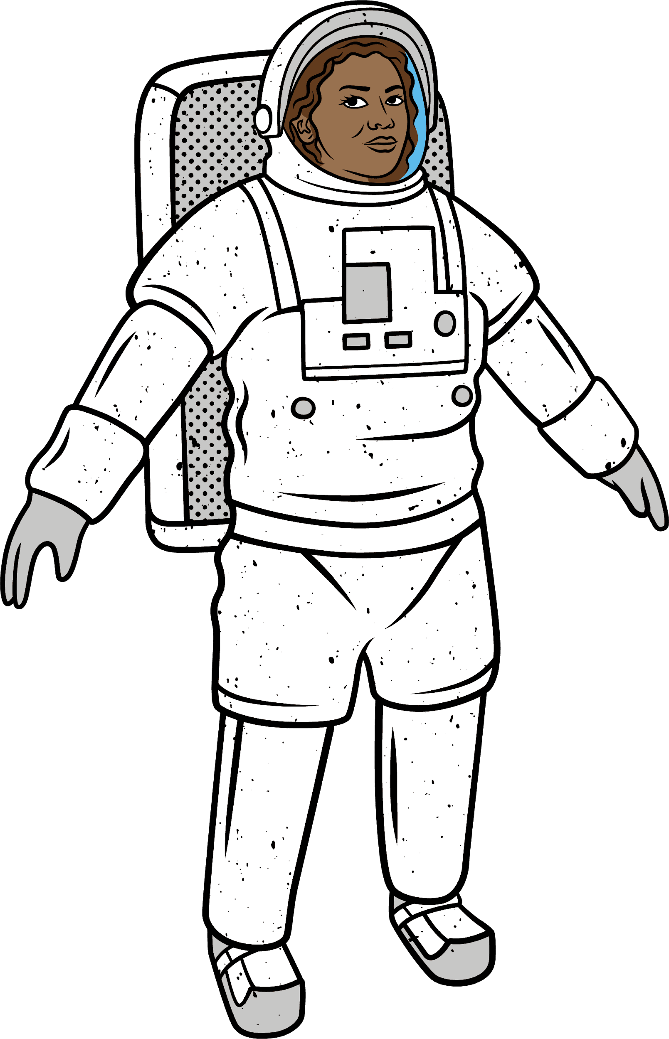
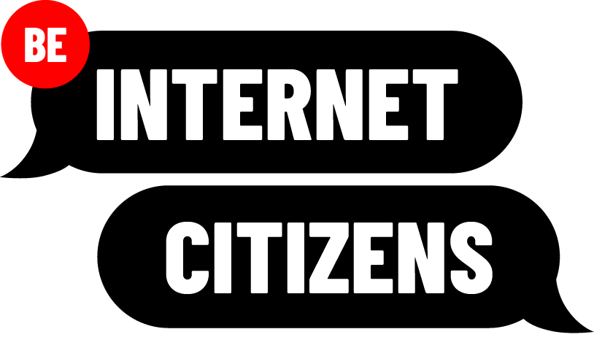
Notes:
These notes are for teachers. They present key questions and points for discussion around the content on each slide. The slide notes are here as a prompt but are not intended to replace the lesson plan, which should be read in detail before the lesson is taught.
On this slide, please introduce the Be Internet Citizens unit of work, which seeks to empower students to be positive users of the internet, by teaching digital citizenship skills including: identifying and responding to different types of so-called ‘fake news’ (including dis- and misinformation) , raising awareness of ‘us vs them’ thinking in society, and understanding the difference between hate speech and free speech.

Slide 2
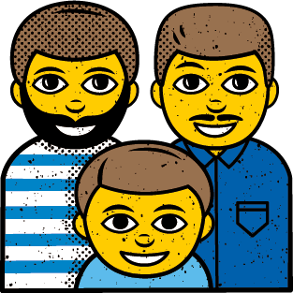
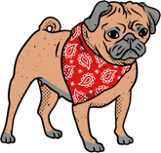
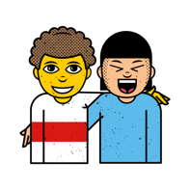
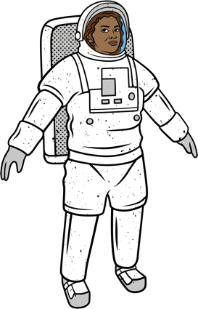
Keep the conversation
Openness
Non-judgmental approach
in the room
Make no
Right to pass
Listen to others
assumptions
Using
language
Seeking help
Asking questions
and advice
Notes:
Teachers should establish ground rules for the lessons in this unit of work. The ground rules on this slide are suggested as talking points.

Slide 3
Fact vs Fiction

Slide 4
Learning Objectives
Learning Outcomes
To understand what the terms ‘disinformation’ and ‘misinformation’ mean, the consequences they have on people, and how to slow their spread online.
Students can identify common traits of dis/misinformation (e.g. website format, URLs, Twitter profiles).
Students can explain potential motives for posting inaccurate information online and describe how it impacts on individuals and society.
Students can list effective responses to dis/misinformation when encountered online (e.g. fact-checking and reporting).

Slide 5
True or False?
Insert example of disinformation

Slide 6
True or False?
Insert example of misinformation

Slide 7
True or False?
Insert example of fact-based news
Notes:
Key questions to guide discussion:
What is the difference between the two types of inaccurate news stories here?
Why might the term fake news be unhelpful?
Can you think of examples of dis- and misinformation you have seen, both on- and offline?

Slide 8
Disinformation
Disinformation refers to any information that has been deliberately created to deceive people or give them an inaccurate understanding of an issue. It is often presented as being fact-based but in reality is intentionally false.
Notes:
Teacher provides students with definition card for ‘Disinformation’.

Slide 9
Misinformation
Misinformation refers to the accidental sharing of false information. While there is no intention to harm, the negative consequences can be just as powerful. It can mislead friends and colleagues, increase confusion around a topic, create divisions between groups or communities, and in extreme cases put people in danger.
Notes:
Teacher provides students with definition card for ‘Misinformation’.

Slide 10
Case Studies
Read through or watch your example of information that has been shared online.
In your groups, discuss:
Do you think this information is trustworthy?
Why is/isn’t it trustworthy?
Do you think this content should be shared around online?
Answered these questions?
Now plan a short presentation of your case study to give to the rest of the class.
Notes:
Key questions to guide discussion:
Who is the source of this information?
Have you heard of them before?
What makes you suspicious about whether to trust this content?
What details do you notice about the appearance of this content?
Should this content be shared? Why/why not?

Slide 11
Different Types of False Information
Deepfake Videos
Conspiracy Theory
Clickbait
Misinformation

Slide 12
Fact vs Fiction
As a class, write a list of the key indicators of dis- and misinformation:

Slide 13
Case Studies
In your groups, discuss:
Why do you think someone produced this content?
What effect did they want to have on their audience?
How does it attempt to produce this effect on its audience?
Why might someone feel compelled to share this?
What consequences might this have on people if it was widely shared?
Extension: what steps might you take to counter the spread of this information if you discovered it online, or saw a friend/relative sharing it?

Slide 14
Final thoughts…
List the top 3 pieces of advice you would give to a friend or family member to help them tackle false information online:
Finished? Complete the first question in your reflective journal.
Notes:
Use this plenary as an opportunity to recap the key learning points and ensure students have made progress towards achieving the learning outcomes.

Slide 15
Support Networks
Want more support or advice? Why not try accessing some of the following websites:
Childline – www.childline.org.uk
The Mix – www.themix.org.uk
Safer Internet Centre – https://www.saferinternet.org.uk/
Relate – www.relate.org.uk (Help for children and young people section)
Samaritans – www.samaritans.org (England, Scotland, Wales)
Thinkuknow – www.thinkuknow.co.uk

Slide 16
Three Sides
to Every Story

Slide 17
Learning Objectives
Learning Outcomes
To learn about different forms of biased writing, and how online filter bubbles can shape our own biases and opinions.
Students can explain what biased writing is and why writers use bias in their work;
Student can analyse the effects of media bias on individuals and society;
Students can define what a filter bubbles is, and explain its impact on individuals/society;
Students can explain the benefits of getting information from diverse sources.

Slide 18
Disinformation?
“Grime is the best music on Earth!”, say world-famous grime artist.
Disinformation or not?
Discuss in your pairs.
Notes:
Key questions to guide discussion on next slide.

Slide 19
Key Questions
In your groups, discuss:
What is the difference between a fact and an opinion?
Does the writer of this headline try to present it as a fact or an opinion?
Can opinions ever be examples of dis- or misinformation?
What is another term for this type of opinionated writing?

Slide 20
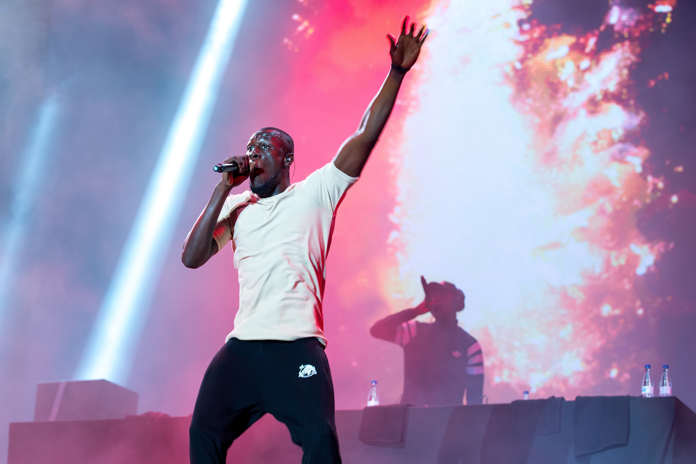
Biased Writing
This type of opinion-based writing is often known as ‘biased writing’:
Biased writing occurs when an author shows favouritism or prejudice towards a particular opinion, instead of being fair and balanced. It is often used to drive people towards certain viewpoints or actions, and can appeal to the reader’s emotions rather than encouraging them to think critically.
Grime is the best music on earth!
Let’s look at some examples of biased writing…
Notes:
Teacher provides students with the definition card for ‘Biased Writing’.
Key Questions for follow-up discussion:
Where have you seen biased writing before?
Can you give an example of a biased opinion?
Are there different types of bias?
What impact can bias have on people?
How can both fact and opinion contribute to public knowledge on a subject?
Is biased writing always bad? What purpose can it serve?

Slide 21
Biased Writing
In your groups, read through your writing extract and discuss:
To what extent is this writing biased?
What marks this out as biased or not?
What does the author want the reader to think when reading this?
Could the author have tried to make this piece more balanced?
As a reader, how could you use the information in this article, and what might you need to get a fuller picture?
Grime is the best music on earth!

Slide 22
Group Feedback
“Emotionally stunted [CELEBRITY] should solve her own issues before going after other people.”
“
“Inspirational [CELEBRITY] calls out horrifying social media ad for promoting fat shaming.”
“[CELEBRITY] and social media company spat over advert finished. Company issues an apology to singer over the advert.”
“

Slide 23
Most shareable?
Grime is the best music on Earth!
“Inspirational [CELEBRITY] calls out horrifying social media ad for promoting fat shaming.”
“[CELEBRITY] and social media company spat over advert finished. Company issues an apology to singer over the advert.”
“Emotionally stunted [CELEBRITY] should solve her own issues before going after Instagram.”
Notes:
Ask students to consider: which stories are people more likely to share online and why? Then use the following key questions to guide the disucssion:
What makes these stories more likely to be shared online (via social media or private groups)?
What are some possible consequences of emotionally manipulative language?

Slide 24
Key Question
In your groups, discuss:
“What can happen online when people react to, comment on, or share content on social media?”

Slide 25
Filter Bubbles
Filter bubbles occur when users are suggested content based on previous internet habits and interactions. Over time they can isolate users from any viewpoints or interests different to their own. Long-term, this can limit people’s understanding of complex topics or events and reduce empathy and dialogue between different groups.

Slide 26
Filter Bubbles
Possible Benefits | Possible Negatives
Notes:
Negatives:
What might happen if we only get our information from sources that all have the same opinion on a topic? (e.g. warped perception of what is happening in the world or what ‘most people’ believe, forming beliefs based on peer pressure as opposed to research and debate, become alienated from people who think differently about a topic or event).
What might happen if we only look at content that is targeted towards us on social media? What skills might we be limiting? (e.g. missing out on new experiences and opportunities, becoming more susceptible to advertising and marketers, easier to target with scams).
Positives:
When might it be useful to have content targeted at you personally? (e.g. adverts for products, notifications of music and sporting events, news about your favourite show or celebrity).
What positives might come from being directed towards people with similar interests to you online? (e.g. forming communities and friendships around common interests, greater sense of belonging and support, people who understand your viewpoint)

Slide 27
Class Checklist
Create your own checklist of steps you can take to assess the quality of information online:
E.g. Establish the source of information and whether it is reliable
Notes:
Establish the source of information and whether it is reliable
Fact-check suspicious information by using sites such as fullfact.org or by looking at other, trusted websites
Use common-sense to consider how likely the information is to be true. Does it sound ridiculous and unbelievable? If so, even a brief Google search could expose it as false.
Use functions such as reverse image search to identify the source of suspicious looking or controversial images.
Analyse the headline to gauge how realistic a news story might be. Read on to check the story matches the headline. Top rule: never share an article without reading it yourself, even if the headline seems exciting/relevant to your friends or relatives!
Consider the motivations of the writer. Who are they trying to convince, and why might this be?
Question how balanced or biased the information is; does it take a range of views into account, or are the sources one-sided?
Before reacting online, consider your own response to the information: has it made you feel a certain way, and if so why? Do you feel you have enough information to form a view? If so, is it responsible to share what you have read or seen with others?

Slide 28
Support Networks
Want more support or advice? Why not try accessing some of the following websites:
Childline – www.childline.org.uk
The Mix – www.themix.org.uk
Safer Internet Centre – https://www.saferinternet.org.uk/
Relate – www.relate.org.uk (Help for children and young people section)
Samaritans – www.samaritans.org (England, Scotland, Wales)
Thinkuknow – www.thinkuknow.co.uk

Slide 29
Us vs Them

Slide 30
Learning Objectives
Learning Outcomes
To understand what stereotyping is and how it leads to ‘us vs them’ thinking.
To reflect on individual biases and how they affect our opinions and worldview.
Students can explain what stereotyping is and the consequences it can have on individuals and groups in society.
Students can identify instances of ‘us vs them’ thinking in individuals’ lives and wider society.
Students can explain what an echo chamber is and understand the positive and negative consequences associated with them.

Slide 31
Immediate Thoughts?
What are these images of?
Mind-map any words that pop into your head when you look at each image.
Write down exactly what you think of, keeping it appropriate – try not to filter your own thoughts!
Insert images of celebrities/influencers/athletes/politicians/rappers/people wearing specific brands/etc in this space, then delete this text box.
Notes:
Key Questions:
(*)
Did this word instinctively pop into your head?
Why do you think that was?
Do you think anything influenced your opinion on this person?
Were you surprised by any of the words you chose?

Slide 32
Conscious and Unconscious Bias
Can you think of any examples of online or offline media content that might make you more biased towards something, someone, or a group of people?
What are we doing when we group people together based on a set of biases? (e.g. what is it called if we put someone into a category because they are, for example, a man, woman, white person, black person, religious person?)
What effect do you think this has on society?

Slide 33
Stereotyping
Stereotyping occurs when we categorise or make assumptions about people based on basic characteristics, for example their age, skin colour, physical ability, gender identity, sexuality, religion or even location.
A stereotype presumes that everyone who shares these characteristics is the same, or that superficial aspects about a person can reveal their deeper likes, abilities, preferences and habits.
Notes:
Teacher provides students with definition card for ‘Stereotyping’.

Slide 34
Mission to Mars
Split into two teams: Rover and Discover
One team has the opportunity to travel to Mars and restart humanity… But only the most skillful team will go!
Your mission: look at your skills and justify why they will be important in creating a new world.
Then look at the other teams; are your skills better?
Argue your case for the chance to see space!
Notes:
Provide each group with Handout 3 - the list of team skills
Key Questions:
What skills does your team have that the other lacks?
Why would your crew be useful in this scenario?
Which team is more practical/ creative/varied/successful?
What makes your crew special in comparison to the other group?
Why is the other group unsuitable for this task?

Slide 35
How would you describe…
Your Team | Their Team

Slide 36
Us vs Them
An ‘us vs them’ mentality divides the world into negatively viewed or stereotyped out-groups (them), and positively viewed or victim in-groups (us).
Divisions can be based on a wide range of characteristics such as race, religion, gender, class, nationality, and political views. It can even relate to culture, for example which sports team a person supports or what music they listen to.
Notes:
Teacher provides students with the ‘Us vs Them’ definition card.
Key questions:
What emotions did you feel while playing the game?
How competitive did you get?
Why do you think this was?
Now you have learnt about the ‘us vs them’ mentality, can you imagine how powerful this feeling might be if the game was based on differences in identity, culture, politics or religion?
Can you think of examples of where you have seen the ‘us vs them’ mentality in action, either on or offline?
How does an ‘us vs them’ mentality affect both individuals and communities?
Can what we see online reinforce ‘us vs them’ thinking, and support our existing biases? What type of content might do this, and how does it affect us?
Thinking back to the last lesson, how should we respond when we see something online that provokes an emotional response?

Slide 37
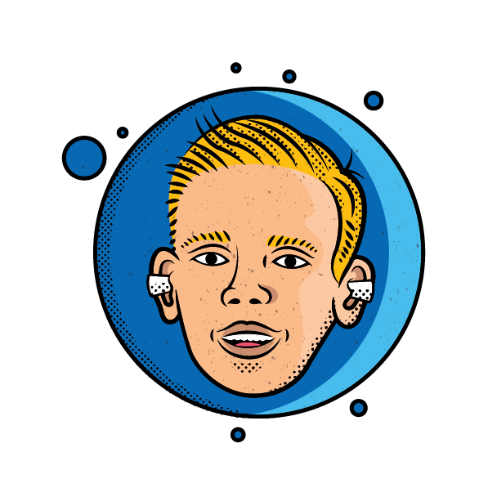
Echo Chambers
Echo chambers are social spaces in which ideas, opinions and beliefs are reinforced by repetition within a closed group.
Notes:
Teachers provides students with the ‘Echo Chamber’ definition card.
Key questions:
How did being a part of a group during ‘Off to Mars’ affect your own behaviour, and the groups’ behaviour as a whole?
Think back to filter bubbles from the last lesson: if we only spoke to people with the same interests, opinions, and biases as us, how might that affect the way we view certain topics?
How might this affect the way we relate to other people (‘them’), who are not a part of our groups?
What could the consequences of us vs them and echo chambers be?

Slide 38
Building Bridges
In pairs: produce a list of ways that you might be able to bridge divides between individuals or communities.
(To get started you could consider: which social media stars do you know that promote positive messages to bring people together? How do they do this?)

Slide 39
Final thoughts…
Complete the following questions in your reflective journal:
How might people stereotype you, and why would this be inaccurate?
What adjectives do you wish they would use instead?
How has this lesson changed how you feel about yours and other’s identity?
Notes:
When considering how to recognise and counteract their own and others’ biases, students could mention the following:
Actively listening to other people’s perspectives rather than automatically judging them
Pause to consider your own response to information or interactions
Embrace diversity
Avoid generalisations about individuals or groups

Slide 40
Support Networks
Want more support or advice? Why not try accessing some of the following websites:
Childline – www.childline.org.uk
The Mix – www.themix.org.uk
Safer Internet Centre – https://www.saferinternet.org.uk/
Relate – www.relate.org.uk (Help for children and young people section)
Samaritans – www.samaritans.org (England, Scotland, Wales)
Thinkuknow – www.thinkuknow.co.uk

Slide 41
Speaking Up, Speaking Out

Slide 42
Learning Objectives
Learning Outcomes
To understand the difference between free speech and hate speech, and how to effectively respond to online hate and abuse
Students can define freedom of speech and explain the benefits it offers citizens and wider society;
Students can define hate speech and identify cases online;
Students can explain the real-world harm caused by online hate speech for themselves and others;
Students are confident using a range of responses to hate speech and verbal abuse online

Slide 43
Free Speech
Free speech is the right to hold opinions, and to receive and share information and ideas freely, without fear of retaliation or censorship by the government.
Notes:
Teacher provides students with the ‘Free Speech’ definition card.

Slide 44
Silent Discussion
Walk around the room silently, reading the questions posed on each piece of paper on the desks.
Respond to each question with your own answer.
Then reply to or comment on other people’s responses or questions.
Notes:
Key questions:
How do we all benefit from being able to share and listen to other points of view?
How does being able to express ourselves help us to grow as people?
Do people exercise their right to free speech online as well as offline? On what different platforms?
How can we communicate positively and effectively with others

Slide 45
Key Question
“Should we communicate to people online in the same way we communicate in the real world?”
Notes:
Key questions:
What are the benefits of effective communication?
How does ineffective communication affect individuals or groups?
How can online communication differ from offline communication? Is this better/worse? Why?
Should our behaviour be any different online? Why/why not?
Which offline behaviours should we replicate online?
How do people abuse the right to free speech online?

Slide 46
Hate Speech
Hate speech attacks a person or group based on their race, religion, sexual orientation, gender identity, and/or physical and mental abilities.
These are sometimes referred to as ‘protected characteristics’, i.e. things about an individual which cannot be changed, are central to their identity or ‘make a person who they are’. As such, abusing someone or discriminating against them because of these factors is prejudiced and unfair.
Notes:
Provide students with ‘Hate Speech’ definition card.
Key questions to guide the discussion on hate speech:
What drives someone to post something hateful online?
How might they be feeling?
Why might they be feeling this way?
Does the fact that they are posting online change the way they might express their views?
Does online hate speech always reflect how the person posting it truly feels?
If not, then why do they post?
What are different ways in which hate speech might impact an individual on the receiving end?
How does it affect society as a whole?

Slide 47
Case Studies
You see a debate taking place in the comments section under an image of a footballer, about whether male or female players should be paid the same amount of money.
In your new groups, read through your case studies and discuss:
how someone should respond if presented with these scenarios in reality
the impact the scenarios could have on individuals involved
the impact the scenarios could have on wider society
Notes:
Distribute copies of Handout 4 for each group to use.
Gather student feedback on how they think they should respond to online hate speech before moving to next slide

Slide 48
How to respond
Flag or Report
Respond
Block
Ignore
Counter with positivity

Slide 49
In your groups
Statement #1
Read through your nine statements
Arrange them into a diamond shape, in order of how far you agree with them!
Remember – the statement you agree with the most goes at the top, the one you disagree with the most goes at the bottom.
Statement #2
Statement #3
Statement #4
Statement #5
Statement #6
Statement #7
Statement #8
Statement #9
Notes:
Distribute copies of Handout 5 to all groups to use here.
Key questions to guide the discussion:
What similarities did you notice between the groups?
What have most people prioritised, and why?
Does anyone disagree with the general consensus?

Slide 50
Exit Pass
Note down your key learnings from today:
3 actions you could take to help challenge online hate and abuse;
2 measures to keep safe while taking these actions;
1 aspect of being a good digital citizen you want to learn more about.
Notes:
Provide students with Handout 6 to help them complete this activity.

Slide 51
Support Networks
Want more support or advice? Why not try accessing some of the following websites:
Childline – www.childline.org.uk
The Mix – www.themix.org.uk
Safer Internet Centre – https://www.saferinternet.org.uk/
Relate – www.relate.org.uk (Help for children and young people section)
Samaritans – www.samaritans.org (England, Scotland, Wales)
Thinkuknow – www.thinkuknow.co.uk

Slide 52
Becoming an
Internet Citizen

Slide 53
Learning Objectives
Learning Outcomes
To understand what digital citizenship means to them and consider actions to demonstrate it.
Students have a personal and/or class definition of Digital Citizenship and what it entails (skills, behaviours, attitudes, knowledge);
Students can articulate positive uses of the internet and how they might get involved;
Students can design online content which promotes their ideas in an inclusive, engaging and appropriate manner.

Slide 54
What does
a good digital
citizen look like?
Co-construct the ideal digital citizen in your groups. You could include:
Skills
Adjectives
Personality
traits
Actions
Notes:
Key questions to guide the students’ thinking on what makes a good digital citizen:
How does a good digital citizen approach new information they find online?
Where does a good digital citizen get and verify their information online?
How do good digital citizens play a positive role in their online communities (e.g. a private instant messaging group, public page, or posts on their profile)?
How does a good digital citizen react when they see something provocative or emotive online?
What attitudes does a good digital citizen demonstrate when interacting with others online?
What actions might a good digital citizen take to improve interactions online?
What actions might they take to contribute to solving real-world problems (e.g. joining/starting a campaign, sharing educational resources, signing a petition)?
How would a good digital citizen respond when they see others being bullied, harassed or mocked unfairly?
What would they do if a close friend or family member shared false, offensive or otherwise harmful information on social media?
What would they do if a funny but suspicious meme was going viral in their friendship group?
What actions might they take to help solve real-world problems (e.g. joining/starting a campaign, sharing educational resources, signing a petition)?

Slide 55
Our class definition:
A good digital citizen is somebody who...

Slide 56
Research Time!
Using the available computers and/or tablets, research examples of inspiring digital citizenship. To help get started, consider the following:
Where have you seen people using the internet/social media to promote a positive message?
Where have you seen the internet used to provide a solution or push for change on an important issue?
Which influencers do you admire? What do you like about what they say, and how they say it?

Slide 57
Research Time!
While researching, consider the following questions:
What positive message is this person or group trying to promote (or which issue are they helping to resolve)?
What platform and/or tools are they using to communicate their message? Have they enlisted the support of others? How did they encourage people to participate?
How does viewing their content make you feel?
What evidence is there for their success?

Slide 58
Campaign crew!
Content crew!
Plan or join a digital campaign focusing on an important issue:
Anti-hate or bullying
Dis/misinformation
Community Action
Deliver an inspiring message for your target audience by producing:
Video content
A speech or PPT presentation
A spoken word piece, poem, or song
Notes:
N.B. Filming should only occur where students and parents have given consent, and any footage should be used and stored in line with school policy.

Slide 59
Campaigns and Content
When creating your campaigns or content, keep in mind and try to include the following:
An overview of what digital citizenship is, and why it is important
Key facts on the topic they are focusing on;
Different ways in which young people can respond to challenges they find online;
Different examples of how the internet might inspire other young people;
Compelling reasons as to why other people should strive to become good digital citizens.
Notes:
For students who choose to plan or join a campaign, the following supporting documents could help provide structure:
Planning doc A (Handout 6) - joining existing campaigns
Planning doc B (Handout 7) - starting a new campaign

Slide 60
Showtime!
Share your flair!
If you would like to, you can present your campaigns or content to your class – let others see your creative genius at work.
Offer constructive feedback on each of the presentations you see! Help your classmates improve their work so it can have as much impact as possible.

Slide 61
Congratulations!
Notes:
Provide each student with Handout 9, a list of further resources they can use to continue building their digital citizenship knowledge and skills. Then provide them each with a Be Internet Citizens certificate - Handout 10. These should have each students name written on, ideally in marker pen.

Slide 62
Support Networks
Want more support or advice? Why not try accessing some of the following websites:
Childline – www.childline.org.uk
The Mix – www.themix.org.uk
Safer Internet Centre – https://www.saferinternet.org.uk/
Relate – www.relate.org.uk (Help for children and young people section)
Samaritans – www.samaritans.org (England, Scotland, Wales)
Thinkuknow – www.thinkuknow.co.uk

Slide 63
Thank you

