Slide 1
SUBJECT: PSHE LESSON
EXPLORING THE MESSAGE OF THE FILM

Slide 2
INTRODUCTION TO ‘WALLS’
Two years ago, 8 students from St Wilfrid’s C of E Academy in Blackburn launched a project to make a film to promote Community Cohesion and tackle the issue of extremism.
Community Cohesion simply means:
“A shared sense of belonging for all groups in society.”

Slide 3
THE FILM
Films are often made with an underlying message. As you watch it, start to think about what you think the message behind the film is.
LINK TO FILM

Slide 4
DISCUSSION 1 [4 mins]
In groups of 4-5, discuss the following question:
What was the main message of the film? You need to agree as a group what you think the message of the film is and report back to the class.

Slide 5
The student directors believe these are some of the key messages…
Don’t be afraid to stand up to people who are being a bad influence on you.
Don’t be racist - be aware of people who have extreme or negative views of other people based on their background or skin colour.
Be a positive person - work to make your community stronger.
Avoid stereotypes and judging others - avoid adopting an ‘Us’ and ‘Them’ attitude.

Slide 6
DISCUSSION 2 [4 mins]
In groups of 4-5 discuss the following question:
Why do you think the film was called ‘Walls’?

Slide 7
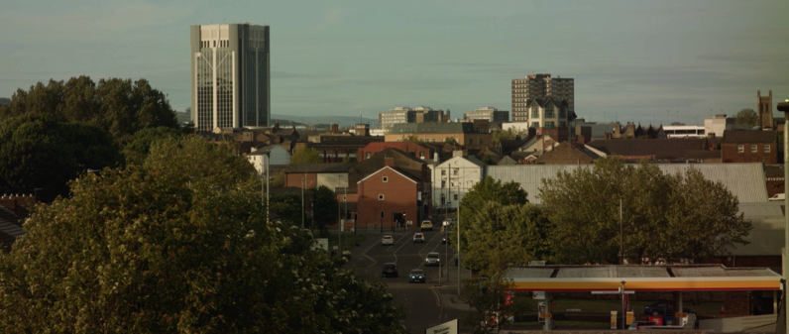
DISCUSSION 3
This film was made in Blackburn, in the North West of England.
On a scale of 1-10, how relevant do you think the film is to your personal experience of attending school in your area?
1 = Not relevant at all
10 = Extremely relevant
2. Why did you give it this rating?

Slide 8
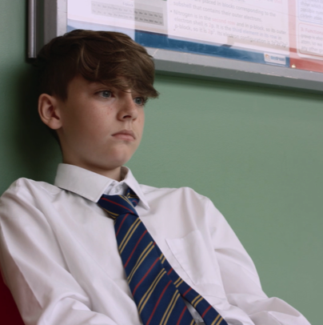
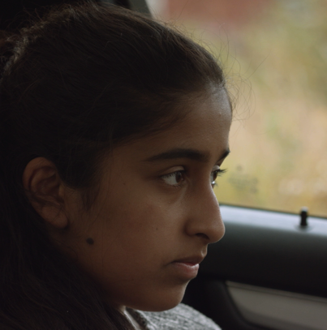
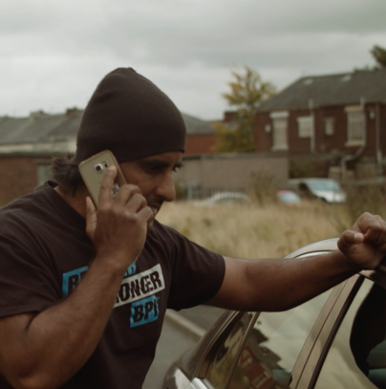
DISCUSSION 4
What can you learn from the 4 main characters?

Slide 9
WRITING TASK
Using your exercise books/e-books, answer the following question:
How does this film make you think about your relationships and attitudes towards other people from a different race or background to you?

